Slide 1
PRESENTATION TO LSSA AGM
20 APRIL 2024

Slide 2
INTRODUCTION
This presentation aims to:
briefly introduce the Legal Practitioners Indemnity Insurance Fund NPC (LPIIF);
explain the services provided by the LPIIF;
highlight LPIIF claim trends; and
highlight how the LPIIF has added value to legal practitioners.

Slide 3
THE LPIIF
The LPIIF:
is a non-life insurance company established by the Legal Practitioners’ Fidelity Fund (the Fidelity Fund) in 1993;
is a non-profit company that provides the insurance services referred to in section 77 of the Legal Practice Act 28 of 2014;
funded by a single premium paid annually by the Fidelity Fund on behalf of insured legal practitioners, i.e., legal practitioners practising with Fidelity Fund certificates (attorneys and trust account advocates); and
provides professional indemnity insurance (PII) subject to the Master Policy to all legal practitioners with Fidelity Fund certificates, bonds of security to attorneys seeking appointment as executors of deceased estates and risk management services to the legal profession.

Slide 4
THE LPIIF MODEL
The model is unique in that we are not aware of any other PII model anywhere in the world where members of an entire profession are automatically insured and the costs of the PII are paid by another entity
As the primary layer of PII covering the entire profession, the LPIIF absorbs most of the risk associated with PII claims. Top-up insurance for the insured practitioners is thus more cost effective (compared to other professions) as most risks are indemnified by the primary layer
In the absence of the LPIIF, legal practitioners would need to purchase PII in the commercial market which would then be more expensive, and some practices would either be uninsurable or only insured on adverse and limited terms

Slide 5
OVERVIEW OF THE LPIIF STRATEGY
To provide sustainable , efficient and cost effective professional indemnity (PI) cover to the legal profession in South Africa while protecting the public interests
A Sustainable Operating Model
Continuous Improvement in process capabilities, systems , technology and human resources & skills for both lines of business
Deploy the required resources in a sustainable and cost effective manner
Build Long Term Sustainability through sound business and regulatory measures
Basic PI cover is paid for by the profession
LPIIF affords own costs
Risk management and mitigation measures
A common risk management system for the entire profession
Implementation of proactive risk management (practice support)
Manage Regulatory Compliance and Enterprise Risk
Incentivise , reward the adoption and sustainable practice of the new risk management system
An enabling regulatory and business environment
Appropriate regulatory regime that balances the interests of the profession and that of the public
Cover and services provided to all practitioners and associated staff
PI insurance is mandatory for all practising attorneys and firms
Further development of the regulatory environment

Slide 6
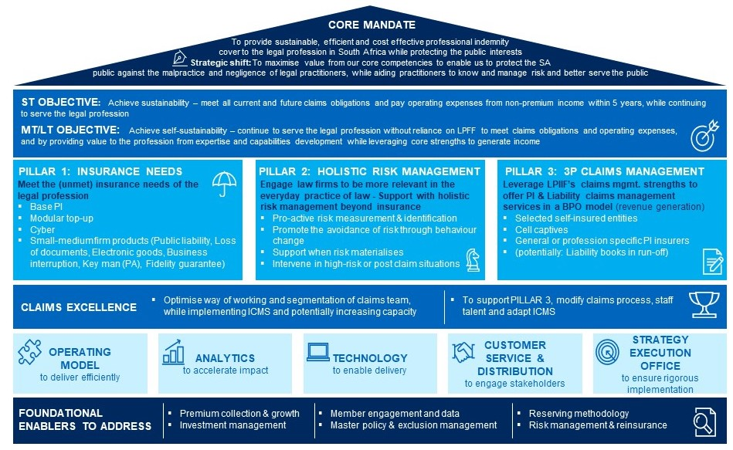
LPIIF GROWTH STRATEGY

Slide 7
LPIIF CLAIM NOTIFICATIONS AS AT 31 MARCH 2024

Slide 8
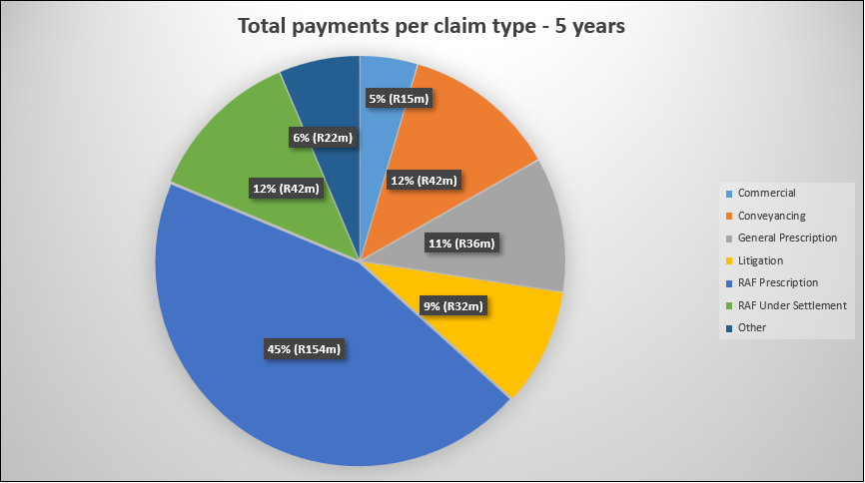
CLAIMS PAID IN THE LAST FIVE YEARS

Slide 9
CLAIM TRENDS

Slide 10
OUTSTANDING CLAIMS

Slide 11
THE LPIIF HAS ADDED VALUE BY
In the last six years, the LPIIF:
paid R412 million for 2074 PI claims notified; and
issued 4080 bonds of security valued at R4 billion and paid R13 million in respect of executor bond claims.
The LPIIF has also:
offered a dedication practitioner support service at no cost to the profession;
serviced the legal profession by providing the base layer of insurance as a risk transfer measure;
enhanced public confidence in the use of legal services;
provided a broad range of educational material;
enhanced its claims administration expertise; and
undertaken litigation to address emerging risks;

Slide 12
RECENT LITIGATION AGAINST THE RAF
RAF related work constitutes a significant portion of the legal services provided in South Africa (particularly by smaller firms)
Recent developments at the RAF with the change in its litigation model and the measures it has sought to introduce for the acceptance and administration of claims have negatively affected plaintiffs and their attorneys, while also increasing potential risk to the LPIIF
In dealing with prescription or under-settlement related claims, the LPIIF absorbs liability that, but for the breaches of mandate, errors or omissions of the legal practitioners concerned, would have been carried by the RAF
The LPIIF’s application to review and set aside Board Notice 271 of 2022 (and the related RAF 1 claim form) was successful
The RAF has now lodged an application for leave to appeal which the LPIIF intends opposing
Board Notice 58 of 2021 was also successfully challenged
The requirements in respect of foreign claimants have also been reviewed and set aside
The LPIIF is working with the respective legal teams in various other tranches of litigation in order to challenge various measures introduced by the RAF that negatively affect claimants and their legal representatives

Slide 13

USEFUL RESOURCES
The LPIIF website www.lpiif.co.za
The LPIIF’s annual integrated reports are available on the website
The Risk Alert Bulletin is available on the Risk Management page of the LPIIF website and on the De Rebus website
The Practice Management column of De Rebus (www.derebus.org.za)

Slide 14
Thank you

