Slide 1
CONTRIBUTION TO THE FIDELITY FUND
BY LEGAL PRACTITIONERS
April 2024
NOVEMBER 2019

Slide 2
The Agenda
The Fidelity Fund - background
The financial position Fidelity Fund
The PI contributions by practitioners
The PI structure in SA

Slide 3
The Fidelity Fund - Background
Carries out statutory functions in accordance with the Legal Practice Act
Faces several challenges in respect of (i) competing interests for its limited revenue, and (ii) also to its own long-term sustainability
Has limited lines of revenue which are listed in the Legal Practice Act
Is faced with existing liability in respect of funding requirements of the LPIIF as well as potential future liability should the LPIIF not able to meet its insurance liabilities from its own assets
Acted in terms of a statutory discretion/ competence (not an obligation) in creating the LPIIF as the vehicle through which professional indemnity insurance (PII) is made available to the legal profession

Slide 4
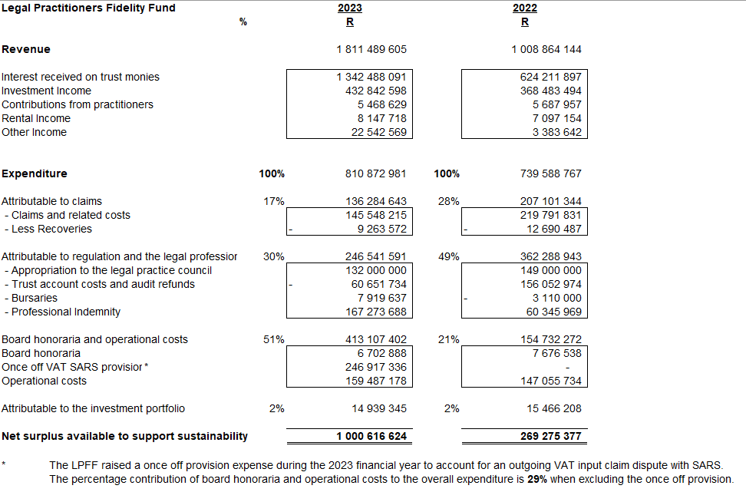
Financial position of the Fidelity Fund

Slide 5
Financial position of the Fidelity Fund continued
If expenditure attributable to claimants, the profession and regulation is greater than trust interest earned, then the return on investments is effectively subsidising the outgo. This will erode the asset base and undermine the Fidelity Fund’s income generating capacity over time
The annual actuarial review introduced by section 73 of the Legal Practice Act is more onerous than the erstwhile regime that existed under the Attorneys Act. Section 73 requires:
  an annual actuarial valuation which reflects the actuarial value of assets and liabilities of the Fidelity Fund;
  a valuation of the financial soundness of the Fidelity Fund;
  that the board submit a report to the Minister of Justice if, at any stage, the value of the assets is insufficient or is not increasing at a rate able to meet the benefits that may be reasonably required. The Minister must then submit this report to parliament. Remedial action will be required. The Fund must take proactive preventative steps to avoid such a situation

Slide 6
Financial position of the Fidelity Fund continued
The Minister will be concerned if the asset-liability ratio shows a steadily declining trend and may lay down clear steps to preserve the Fidelity Fund’s viability if there is increased risk to the solvency of the institution
The section 73 valuation as at 31 December 2022 revealed a solvency ratio of … times. By inference, the Fidelity Fund’s solvency ratio is, at best, acceptable
The Fidelity Fund must thus take urgent steps to address the threats to its solvency ratio. The required steps include relooking at the LPIIF funding model
In November 2017 the Fidelity Fund’s board resolved that practitioners will be called upon to make a contribution to the cost of the primary layer of PII
In June 2023, the Fidelity Fund board resolved that practitioners with Fidelity Fund certificates pay an annual amount of R5000, 00 (five thousand Rands each) as a contribution to the premium funding of the LPIIF

Slide 7
Premium contribution
In the last 9 years, the LPIIF and the Fidelity Fund have, in various forums and through various media, raised the matter of a contribution to be required from the profession
The premium contribution will be implemented from November 2023
The Legal Practice Act and the rules provide the statutory framework for the payment of a contribution to the cost of the primary layer of PII- see sections 74, 77 and rule 51
In determining the required contribution, only the actual claims costs (actuarially forecasted) were considered. There was no consideration for profit. The Fidelity Fund will continue paying for the operating costs of the LPIIF. Practitioners will thus only be contributing to the risk premium

Slide 8
Premium contribution continued
The contribution will be implemented in an incremental/ staggered manner- the profession will only contribute to 50% of the risk premium in the first year, with the Fidelity Fund paying the balance. The contribution from the profession will then increase by 10% annually over the next 5 years
New entrants to the profession will be exempted from paying a contribution in the first 2 years of practice
Risk analysis/profiling will continue to be improved over the years. The contribution will increasingly consider the risk profile of the practitioner- factors such as firm structure, area/s of practice, gross fee income and the implementation of risk management measures in firm will be considered in assessing the risk
The LPIIF is a registered non-life insurer and must, as part of its regulatory requirements, meet the prescribed required minimum capitalisation and solvency requirements

Slide 9
The PII model in SA
The legal profession in South Africa is in a uniquely advantageous position in that:
A primary/ base layer of PII is provided to every practitioner who is in possession of a Fidelity Fund certificate on a similar basis
Since 1993, the Fidelity Fund has borne the costs of the provision of the PII
The Fidelity Fund has provided the vehicle (the LPIIF, a non-profit company) through which the primary layer of PII is provided, over and above carrying out its primary purpose (which is the reimbursement of claimants who have suffered pecuniary losses as a result as result of the theft of property or money entrusted to practitioners)
The cost of top-up insurance is for legal professionals is relatively well priced (as compared to other professions and jurisdictions) as most claims and legal defence costs fall into the primary layer and are thus borne by the LPIIF

Slide 10
The PII model in SA continued
The primary layer is the first to respond to all claims- the top-up layer of PII only responds to the portion of the claim in excess of the available limit under the primary layer or, subject to the top-up wording, where the claim falls within one of the exclusions under the LPIIF Master Policy
For 2015 and 2016 the LPIIF was declared a going concern only after letters of comfort for the LPFF.
In 2017, the LPFF re-capitalised the LPIIF and agreed on a funding arrangement for the next 5 years
The factors in the previous bullets were considered in the decision taken by the Fidelity Fund to implement the levying of contributions by practitioners with Fidelity Fund certificates

Slide 11
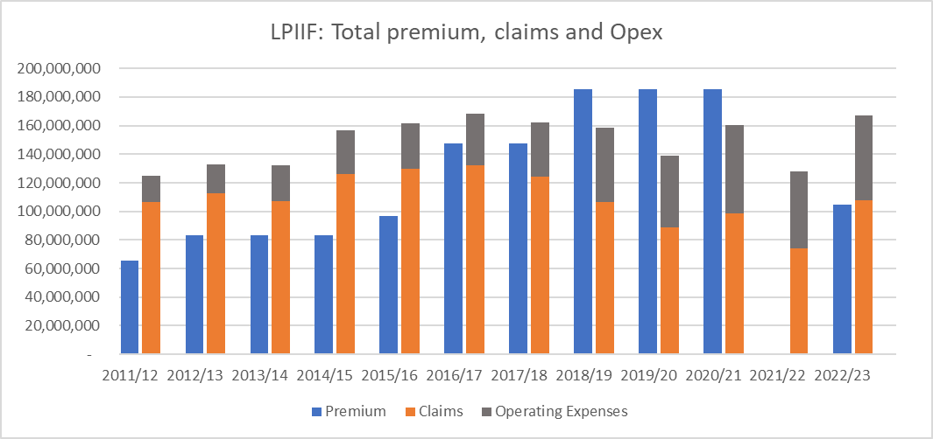
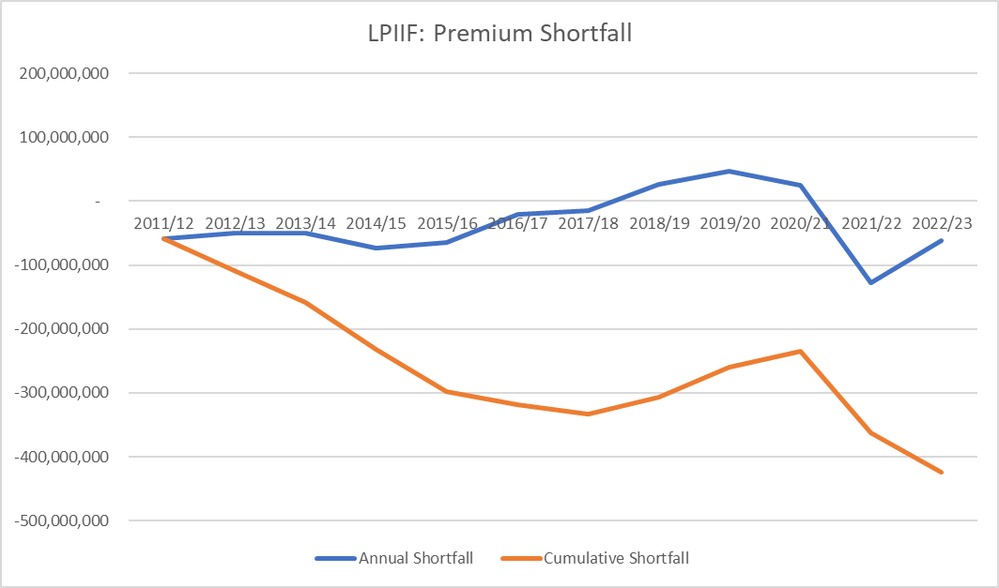

Slide 13
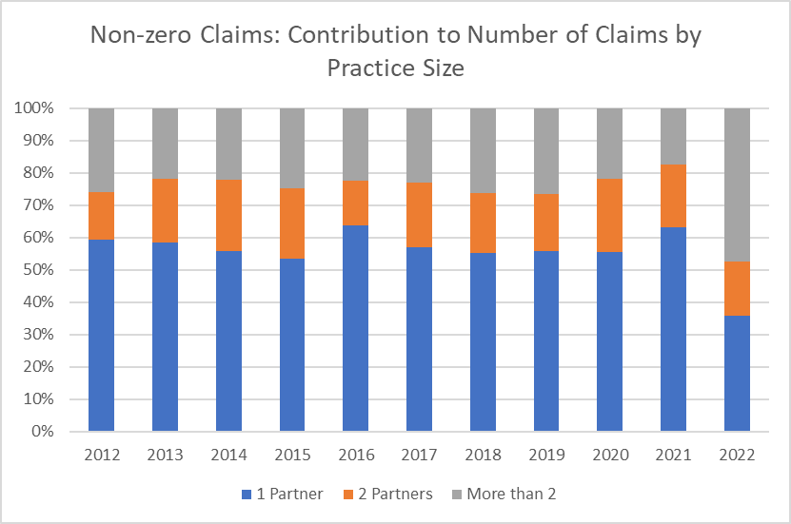
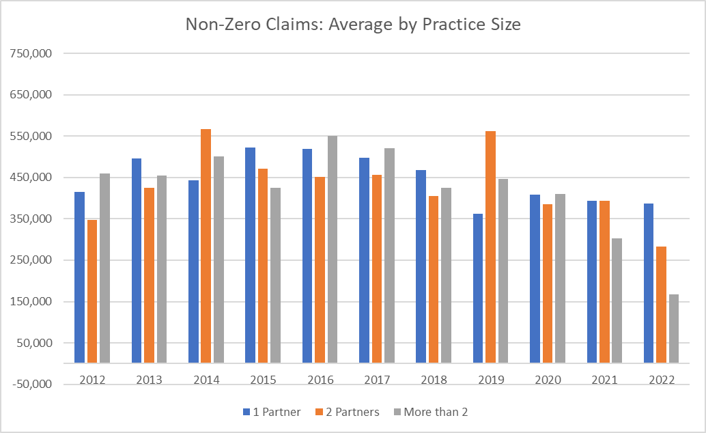
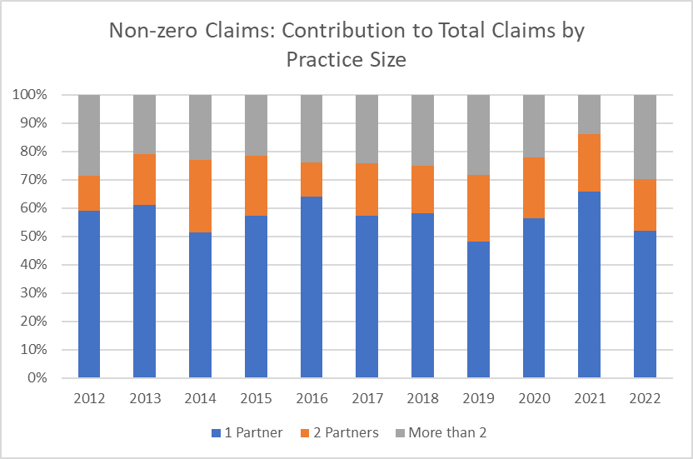
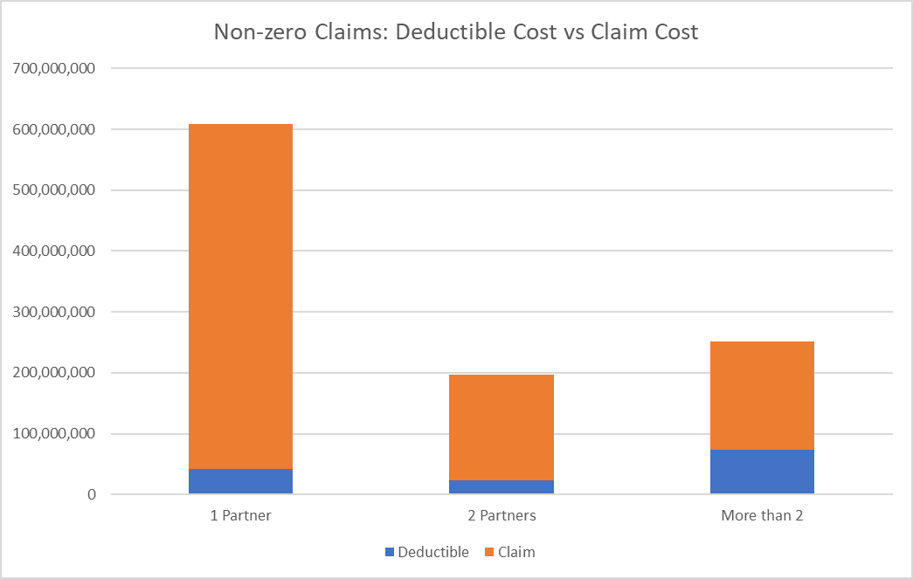

Slide 14
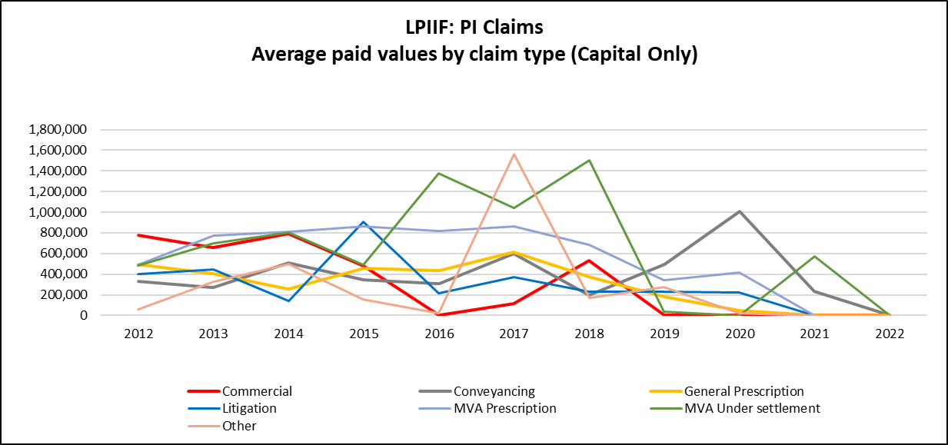
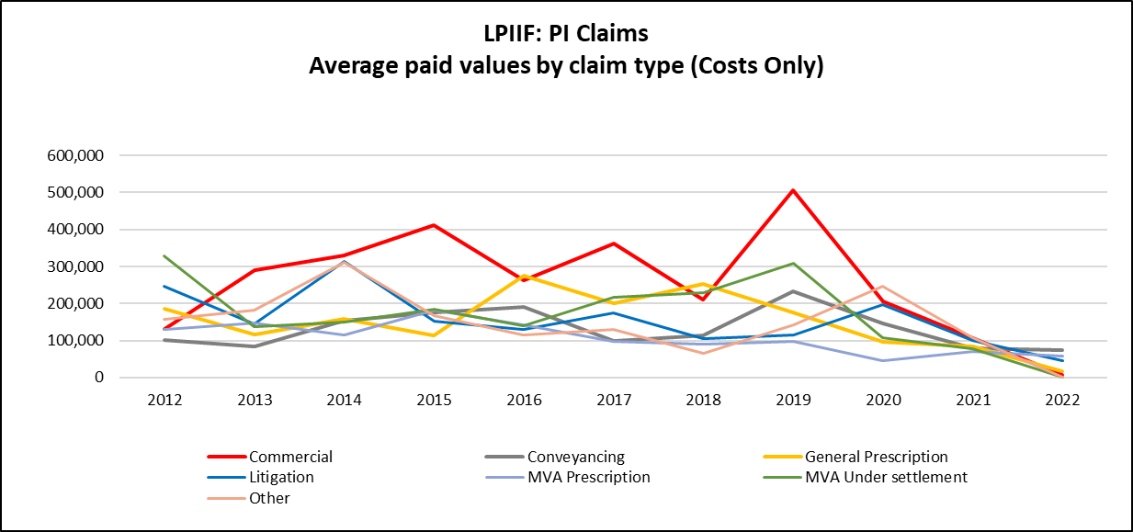

Slide 15
THANK YOU

