Slide 1
Law Society of South Africa AGM
Resolving and Exiting Grey-listing by, and Risk-based Supervision of,
Legal Practitioners
19 April 2024

Slide 2
Discussion points
Resolving and exiting grey listing
Risk and Compliance Return & STR submissions
Inspections and enforcement of the FIC Act

Slide 3
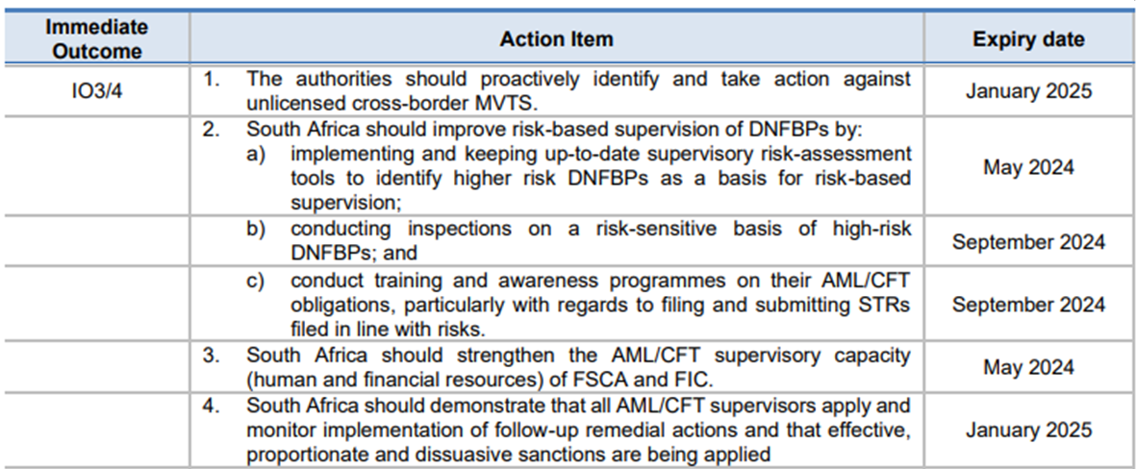
FATF International Co-operation Review Group Joint Group (ICRG JG) process

Slide 4
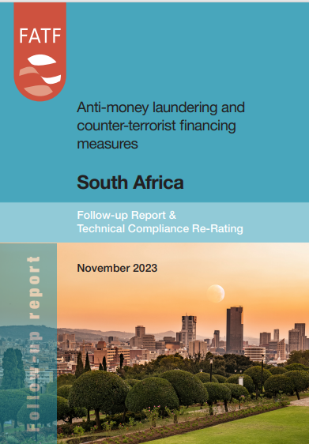
FATF Grey listing – Follow-up Report
Effectiveness not included in the November FUR
The Joint Group meets every 4 months, where SA reports on progress in addressing the 22 action items in the Action Plan
Completing the action plan is required to exit the “grey list”
SA’s progress in addressing the 20 technical compliance deficiencies identified in the 2021 FATF MER
27 October 2023, the FATF Plenary formally re-rated 18 of the 20 deficiencies
Significant legislative amendments is support of this:
  The General Laws (Anti-Money Laundering and Combating Terrorism Financing) Amendment Act, No. 22 of 2022 and
  The Protection of Constitutional Democracy Against Terrorism and Related Activities Amendment Act No. 23 of 2022 and other regulations and directives

Slide 5
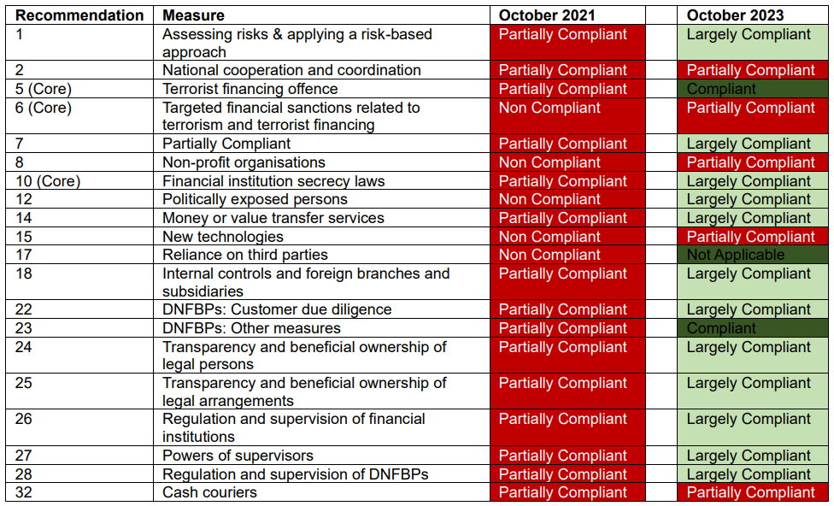
FATF Grey listing – Follow-up Report

Slide 6
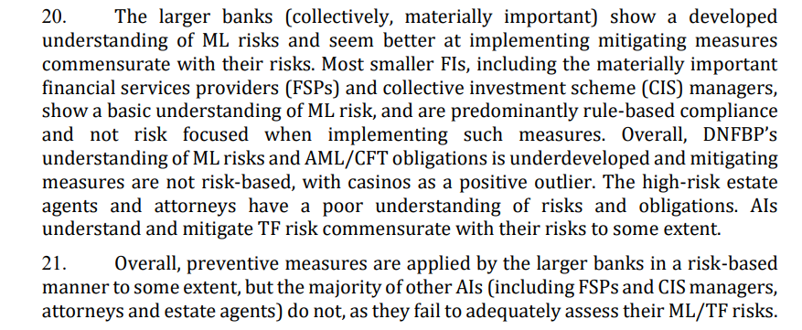
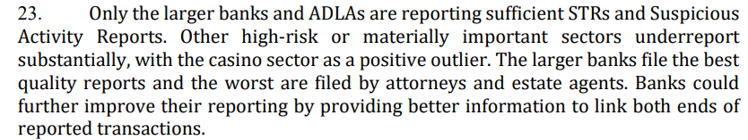
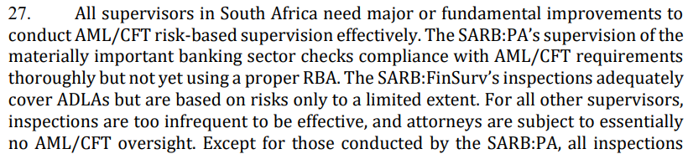
MER extracts

Slide 7
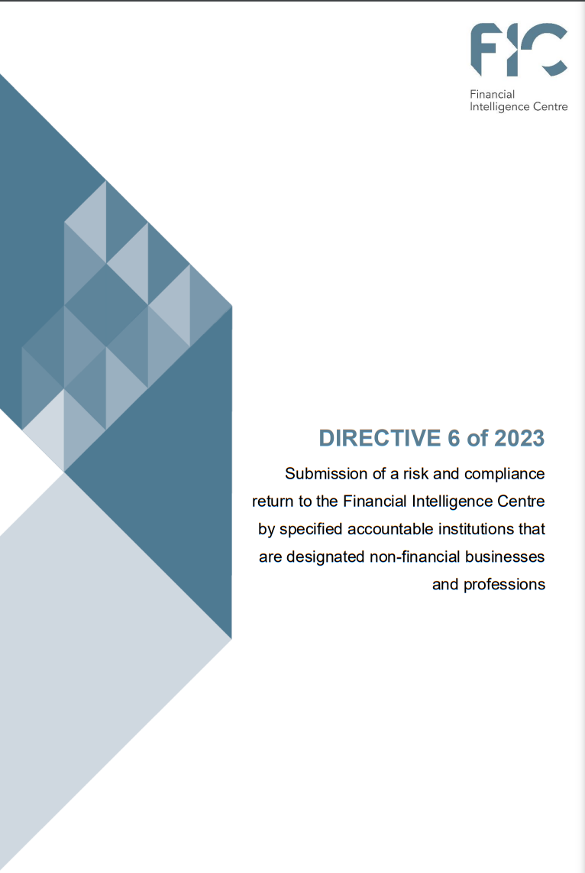
Directives 6: Risk and Compliance Return
DIRECTIVE 6
Who must complete
Supervisory response to RBA
Compulsory for DNFBPs to complete the RCR
Online submissions only
RCR covers the reporting period from 1 April 2022 to 31 March 2023
Due 31 May 2023 (still open)
Potential administrative sanction for non-submission
(section 62E read with section 43A(3) of the FIC Act)
Legal practitioners
Estate agents
Trust and company service providers
Gambling institutions

Slide 8
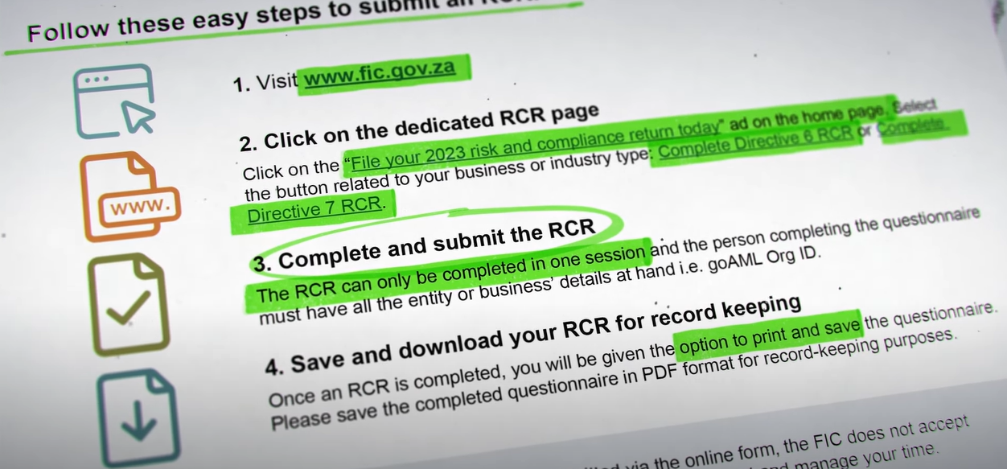
(51) Financial Intelligence Centre risk and compliance return - YouTube

Slide 9
Directives 6: Risk and Compliance Return
Important notes
Only submit RCR if registered with the FIC and FIC Org ID
Submit a separate RCR for each Schedule item registered with the FIC, per FIC Org ID held by an accountable institution.
Separate RCR submission for branch networks, ie 1 RCR per multiple offerings across the FIC Schedule items.
Only one RCR submission is permitted per FIC Org ID held.
Clearly communicate the requirement for submission of RCRs internally in their institutions to avoid duplicate submissions.
Accurately capture their FIC Org ID number in the RCR
    download the annexure first,
    get the required information,
    then submit
Non submission can lead to enforcement action

Slide 10
Directive 6 Reporting by legal practitioners – Risk and Compliance Returns
RCRs submitted in terms of Directive 6 from 31 July 2023 to 31 March 2024
 | 31 July 2023 |  | 31 October 2023 |  | 31 March 2024
 | RCRs submitted | % | RCRs submitted | % | RCRs submitted | %
Legal Practitioners | 6 460 | 38% | 9 187 | 54% | 10 591 | 64%

Slide 11
Reporting of STRs by legal practitioners
STRs reported by legal practitioners during previous 3 years
 | 31 March 2022 |  | 31 March 2023 |  | 31 March 2024
 | Suspicious transaction reports | Number of registered entities | Suspicious transaction reports | Number of registered entities | Suspicious transaction report | Number of registered entities
Legal Practitioners | 306 | 16 583 | 505 | 16 480 | 466 | 16 465

Slide 12
FIC Supervisory Model & Approach
RCR non compliance
Inspection findings
Registration
Public Awareness & Public QueriesRegistration
High/High
High
RCR & the RCAA
FIC Act
SRAs (EAs, LPs)
NRAs
Public Compliance Communications & Guidance Notes
Compliance Monitoring
Medium High
Medium
Inspections
Enforcement

Slide 13
Supervision of Attorneys 2023-2024
FATF requirement – Inspections must be risk-based
273 inspections completed
137 on RCR (FIC Directive 6) non-compliance
Most inspections in Gauteng, Western Cape and KZN, but footprint across country
Alarming non-compliance found
:

Slide 14
2023-2024 Inspections on Attorneys
Key findings:
No business risk assessment and no RMCP
RMCP but no business risk assessment
The adoption of industry guides – names are inserted on documents without any application of mind
CDD is not conducted in manner that is set out in RMCP -
CDD not tailored with attorneys' risks
Reluctance to report suspicious and unusual transactions

Slide 15
RCR non-compliance findings
Directive 6 | Count
Compliant with Directive 6 | 43
RCR Submitted late (Directive 6) | 38
Not Compliant with Directive 6 | 30
RCR submitted after receipt of inspection notice | 27
Grand Total | 138

Slide 16
Targeted Financial Sanctions & TF
TPRs (TFS) | Count
Not compliant- no client screening against TFS list | 74
Compliant | 26
Not assessed | 14
No screening evidence kept | 12
Not Assessed | 4
Grand Total | 130

Slide 17
FIC Act Enforcement
FATF requirement - administrative sanctions must be effective, proportionate and dissuasive
302 - RCR Notices of Intention to Sanction (Admission of guilt: Remedial action + Financial penalty)
9 – Sanctions issued for non-compliance (Small fines going up to R7, 7 Million)
Remedial action/changing compliance behaviour paramount in all enforcement action

Slide 20

ADDITIONAL READING: legislative updates & definitions

Slide 21
Summary of legislative changes – inclusion of trust advocates in Item 1
14 Nov 2022
CTR
19 Dec 2022
Schedules
31 Dec 2022
FIC Act
7 Jan 2023
POCDATARA / FIC Act
1 Feb 2023
IFTR
CTR regulation 22B updated
2 days to 3 days
R24 999.99 to R49 999.99
CTRA deleted - if person is suspected of depositing linked amounts to avoid CTR report, must submit STR.
Schedule 1 updated
Item 1 updated to include Trust advocates
Item 2 updated TCSP includes company providers, accountants...
Item 7A Co-operative banks ^{(new)}
Item 11 Updated to now include a wider category of credit providers
Item16 Ithala removed (will be regulated under I11)
Item 19 Amended to money or value transfer provider
Item 20 High value goods dealers ^{(new)}
Item 21 South African Mint company ^{(new)}
Item 22 Crypto asset service provider ^{(new)}
Item 23 Clearing system participant ^{(new)}
Schedule 2 updated
Independent Regulatory Board for Auditors ^{(removed)}
Legal Practice Council ^{(removed)}
National Gambling Board ^{(removed)}
Schedule 3 updated
KR Dealer ^{removed} (inc. to item 20)
MV Dealer ^{removed} (inc. to item 20)
Schedule 3A amended RE ^{new} PEP terminology
Schedule 3B amended RE ^{new} PEP terminology
Schedule 3C added (another PEP category) – PIP
For 3A, 3B and ^{(new)} 3C preceding 12 months removed, once a PEP always a PEP.
General Law Amendment Act approved
New powers and functions for the FIC: Able to form public-private partnerships & Can produce forensic evidence regarding financial flows
Can share information with auditor general. FIC can request information from organ of state databases.
s21B - amended to include every natural person who is a beneficial owner of a legal person, trust or partnership. This is known as the “look through” (standardised UBO wit Companies Act.)
s21C - If the AI wants to submit a STR report and they reasonably believe that performing CDD will tipoff the client acting suspiciously, then it may discontinue the CDD process and file an STR.
s21D-. AIs need to repeat the CDD process when an STR report is submitted to the FIC.
PEPs S21F, G & H and Schedules 3A, 3B and 3C: removal of FPPO and DPIP, replaced with Domestic Politically Exposed Person (DPEP,) Foreign Politically Exposed Person (FPEP) and Prominent Influential Person (PIP) - new category, inclusions into S42(2)(l). PIP list can be updated by the MoF (s79C)
S42(2) - Proliferation financing risk must be included in RMCP.
S42(2)(q) How internal branches handle the exchange on information and confidentiality of information, group wide RMCPs, especially regarding STR analysis must be included RMCP.
S42(2)qA - How AIs will apply additional compliance process if host country doesn't implement FIC Act must be included RMCP.
Powers given to the Minister to remove Supervisory Bodies (s75)
Definitions, inclusions
 Proliferation financing  PIPs  Beneficial owner
Administrative sanctions
 S49A failure ito S26B (TFS)  S50 failure ito S27 (access to info)
 S52 failure ito S29 (not just criminal)  S57 failure ito 32/45 (comply with request)
 S64 failure ito avoidance of reporting duties
Schedule 2 updated
Estate Agency Affairs Board removed
Provincial gambling boards removed
Changes to TFS provisions in POCDATARA
Deletion of S25 of POCDATARA (President and SAPS no longer publish)
Inclusion into s26A
Reference removed in S28A
Only 1 listing ito TFS, found on the FIC website. Per S26A
Focus on the updating of TFS list to be "without delay."
IFTR implementation
Section 31 in force
R20 000 and above
Cross Border electronic payments, including CMA
Specific institutions who conduct cross border payments such as ADLAs and ADs to submit IFTR
Reportable within 3 days
Go Liv date 1 February 2023

Slide 22
Reporting
S28 – CTR
Cash payment
(CTR)
S29 – STR
Money laundering (STR/SAR)
S28A – TPR
S31 – IFTR
Financial sanctions
(STR/SAR)
Terrorist financing (TFTR/TFAR)
Cross-border money movement
(IFTR)
Terrorist financing (TPR)
Financial sanctions (TPR)
* Only for authorised entities

Slide 23
Cash threshold report
Section 28 FIC act
Triggered by cash threshold of R49 999.99
Cash transactions- Cash, coins, paper money and travellers' cheques (not an EFT)
Report within 3 business days of the transactions
Aggregation no longer applicable
NOTE:
It is prudent and expected that TCSPs monitor their bank accounts daily to identify if cash has been deposited into their bank account
Guidance note 5C

Slide 24
Cash threshold report (continued)
CTR and STR
Where multiple cash payments or a series of cash payments are conducted to avoid detection then an STR must be filed.
It is therefore possible that a cash transaction could give rise to an obligation to report a cash threshold report in terms of section 28 of the FIC Act and a suspicious or unusual transaction in terms of section 29 of the FIC Act.

Slide 25
Suspicious and unusual transaction reporting (STR)
The person must file a section 29 report when that person knows or ought reasonably to have known or suspected that a transaction or activity relates to:
Proceeds of unlawful activity
Unusual sales purchases activity by client
Facilitates the transfer of proceeds of unlawful activity
Has no apparent business or lawful purpose
May be relevant to the investigation of an evasion or attempted evasion of a duty to pay tax or attempted tax evasion
An offence relating to the financing of terrorist and related activities
The contravention of a prohibition under section 26B of the FIC Act and/or
Any structuring of a transaction or activity which is conducted for the purpose of avoiding giving rise to a reporting duty under the FIC Act.

Slide 26
Suspicious and unusual transaction reporting (cont.)
Threshold
No monetary threshold applicable to the reporting of suspicious or unusual transactions.
STR
An STR must be submitted when the suspicion is in respect of a complete transaction or series of transactions relating to the suspicion or knowledge of the proceeds of unlawful activity or money laundering and regarding a transaction or series of transactions relating to a contravention of prohibitions under section 26B of the FIC Act.
Guidance note 4B

Slide 27
Suspicious and unusual activity report (cont)
Suspicious activity report (SAR)
An SAR must be submitted when a suspicion relates to the proceeds of unlawful activity, or money laundering activity or a contravention of prohibitions under S26B of the FIC Act:
  Where the report relates to an activity which does not involve a transaction between two or more parties
  In respect of a transaction or a series of transactions about which enquiries are made but which has not been concluded.
  In respect of a transaction which has been incomplete, interrupted, aborted, abandoned and ultimately not concluded

Slide 28
Useful reading material
National Treasury statement on FUR: https://www.treasury.gov.za/comm_media/press/2023/2023112901%20MEDIA%20STATEMENT-PROGRESS%20IN%20ADDRESSING%20TECHNICAL%20COMPLIANCE%20DEFICIENCIES%20IN%20SOUTH%20AFRICAS%20ANTI-MONEY%20LAUNDERING%20SYSTEM.pdf
Public Compliance Communication 6A https://www.fic.gov.za/wp-content/uploads/2023/09/2023.08-PCC-PCC-6A-Trust-and-company-service-provider.pdf
Draft Public Compliance Communication 121 on Beneficial Ownership - https://www.fic.gov.za/wp-content/uploads/2023/11/2023.11-PCC-231115-Draft-PCC-121_Beneficial-Ownership.pdf
Public Compliance Communication 53 on Risk Management and Compliance Programme - https://www.fic.gov.za/wp-content/uploads/2023/09/2022.08-PCC-PCC-53-RMCP.pdf

